Slide 1

2025 CHNA/CHA Work Group
Monthly Meeting – April 9, 2025

Slide 2

Agenda
Introductions & Housekeeping
Today’s Meeting Goals:
  Discussion of the 2024 Community Health Assessment Survey (CHAS) Data Analysis with Melissa Bauer, DataGen
  Selection of ad-hoc meeting date to select regional PA priorities
Updates
  2025 Key Informant Interviews with CBO Leaders
  2025-2030 Prevention Agenda
Next Steps
Notes:
Here’s today’s meeting agenda. The goal of today’s meeting is to discuss the 2024 CHAS analysis, and select a date for an ad-hoc meeting to select our regional PA priorities

Slide 3

Welcome & Introductions
Thank you for joining us!
Please share your name, role, and organization with the group.
CHAS
Notes:
Let’s please start with introductions. I’ll call on folks as I see them.

Slide 4
Housekeeping
All meeting materials on LIHC website: https://www.lihealthcollab.org/member-resources/meeting-info/2025-chnacha-work-group
Work group meets on the second Wednesday of every month at 2 PM
Notes:
Some housekeeping, all of our meeting materials are on the LIHC website here

Slide 5


2024 Community Health Assessment Survey (CHAS) Data
Presentation of Analysis and Findings, Q&A

Slide 6
2025 Key Informant Interviews with CBO Leaders
28 stakeholders representing 23 different organizations were completed, QA in progress!
Docs for Tots
Stony Brook Cancer Center
STEMM & Cancer Health Equity Foundation
The Society of St. Vincent de Paul LI
Latina Sisters
Cancer Services Program of Suffolk
American Lung Association
Age Friendly Glen Cove
Glen Cove CDA & IDA
Western Suffolk BOCES
Adelphi NY Statewide Breast Cancer Hotline & Support Program
Long Island Coalition for the Homeless
Health & Welfare Council of LI (HWCLI)/HEALI/SCN
Leukemia and Lymphoma Society
Wyandanch Community Center / Town of Babylon
Pronto LI
Catholic Charities
The g6pd Deficiency Foundation
Nassau-Suffolk Hospital Council
Cornell Cooperative Extension of Suffolk
New York Coalition for Transportation Safety
Hands Across Long Island (HALI)
Central Nassau Guidance
Notes:
Thank you all for your efforts to help us secure interviews with community stakeholders and providers
Thank you for your patience as we finish the QA this week

Slide 7
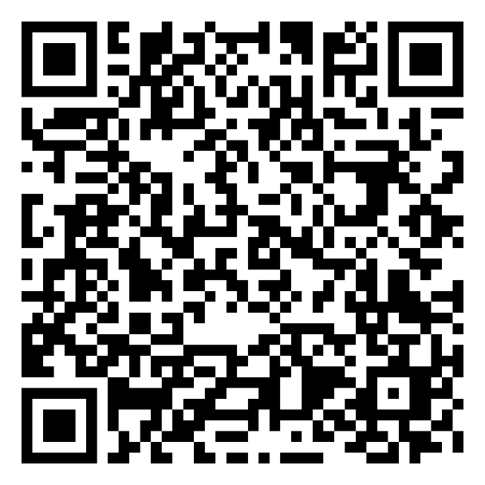
Ad-Hoc Meeting to Select Regional PA Priorities
Please take a moment to provide your availability via Calendly:
https://calendly.com/d/crx5-9n7-b6x/ad-hoc-chna-cha-wg-meeting-to-select-pa-priorities
Notes:
Thank you all for your efforts to help us secure interviews with community stakeholders and providers
Thank you for your patience as we finish the QA this week

Slide 8
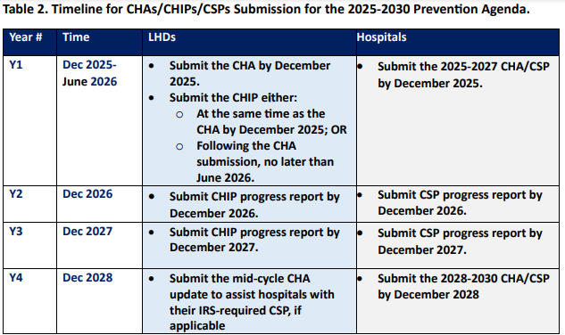
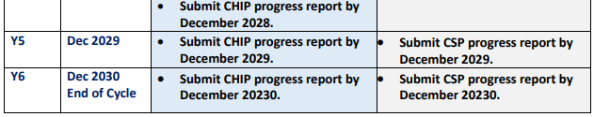
Timeline for CHAs/CHIPs/CSPs Submission for the
2025-2030 Prevention Agenda has not changed

Slide 9
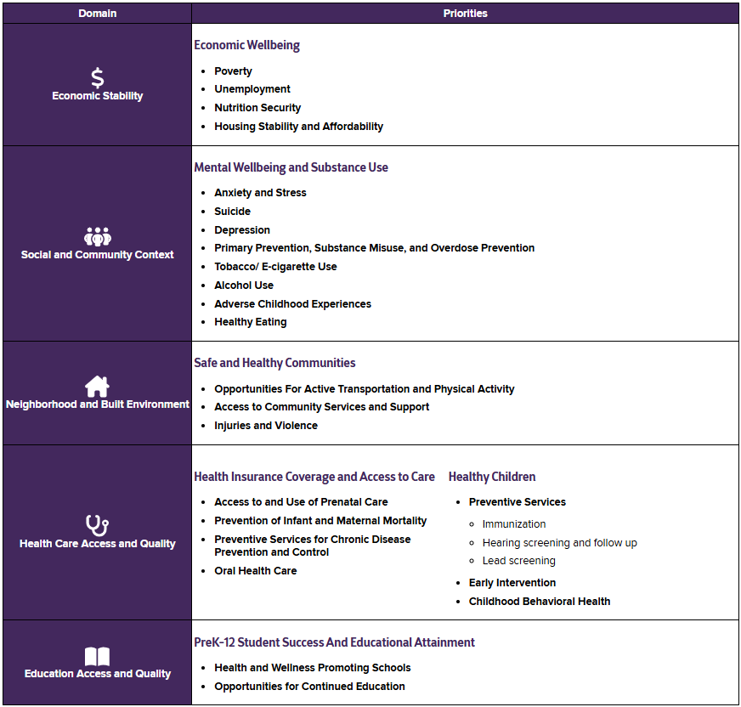
2025-2030 PA Updates
New PA Priorities
Select 3 from list of 24, informed by CHNA/CHA findings
Derived from the five social determinant of health domains from Healthy People 2030
Notes:
Select 3 from list of 24
Not presented as “actionable” items but are simply topics (such as Unemployment, Healthy Eating, Poverty, etc.).
Derived from the five social determinant of health domains from Healthy People 2030 (Economic Stability, Social and Community Context, Neighborhood and Built Environment, Health Care Access and Quality, Education Access and Quality)
Priorities grouped by a category descriptor, also informed by the SDH domains
Selection of at least one of the following social determinants of health is strongly encouraged:
Poverty
Unemployment
Nutrition Security
Housing Stability and Affordability
Health and Wellness Promoting Schools
Opportunities for Continued Education

Slide 10
2025-2030 PA Updates
Prevention Agenda 2025-2030
  Implementation phase began on March 1
  New NYS Workplan Template (Excel) available for download on NYSDOH website
  Links on LIHC website
Notes:
Select 3 from list of 24
Not presented as “actionable” items but are simply topics (such as Unemployment, Healthy Eating, Poverty, etc.).
Derived from the five social determinant of health domains from Healthy People 2030 (Economic Stability, Social and Community Context, Neighborhood and Built Environment, Health Care Access and Quality, Education Access and Quality)
Priorities grouped by a category descriptor, also informed by the SDH domains
Selection of at least one of the following social determinants of health is strongly encouraged:
Poverty
Unemployment
Nutrition Security
Housing Stability and Affordability
Health and Wellness Promoting Schools
Opportunities for Continued Education

Slide 11
2025-2030 Prevention Agenda
DOH Links and Online Guidance – All On LIHC Site
  Prevention Agenda 2025-2030: New York State's Health Improvement Plan: https://health.ny.gov/prevention/prevention_agenda/2025-2030/
  August 21, 2024 Dear Hospital CEOs and LHD Commissioners and Directors Letter: https://www.health.ny.gov/prevention/prevention_agenda/2025-2030/docs/letter_and_guidence.pdf
  November 8, 2024 Dear Hospital CEOs and LHD Commissioners and Directors Letter
  PA Tracking Dashboard: https://apps.health.ny.gov/public/tabvis/PHIG_Public/pa/reports/#county
Notes:
Refer to updated PA dashboard here
Updated PA dashboard to come in the fall

Slide 12
Next Steps
Ad-hoc meeting to select regional PA priorities next week
CHNA/CHA regional report template to come late June
Next Meeting: Wednesday, May 14, 2025, at 2 PM

Slide 13
Discussion, Questions, etc.
Questions, comments, concerns?
Adjournment

