Slide 1

March 28, 2024
Quarterly Hybrid Meeting

Slide 2

Today’s Meeting Agenda
Welcome & Introductions
1115 Waiver Update by HANYS
LIHC Updates
    LIHC Member Spotlight: Health & Welfare Council of Long Island (HWCLI)
    Core Cluster Update
    Community Service Society (CSS) Keep Long Island Covered (KLIC) Grant Final Update by NSHC
    CHNA Work Group Update
    2023 CHAS Analysis by DataGen
    CHAS Toolkit & Promotion
    Ongoing Engagement
    Future Meetings: LIHC is moving!
Discussion
Adjournment

Slide 3

Welcome & Introductions
Thank you for joining us!
Please introduce yourself and tell the group what organization you are representing.
Welcome, Alexis Zizzo, LIHC/NSHC Intern!
Notes:
For those in person, please go around the room and introduce yourself
If you’re attending virtually, please introduce yourself in the chat

Slide 4


NY 1115 Medicaid
Waiver Update
by Colleen McVeigh
Senior Healthcare Informatics Analyst, Healthcare Association of New York State (HANYS)

Slide 5
1115 Waiver Approval Summary
Colleen McVeigh, Lead Strategist – 1115

Slide 6
Overview
Approval through March 31, 2027
Approximately $7B
Initiatives
  HRSN Infrastructure and Services
  Strengthen Workforce
  Population Health

Slide 7
Medicaid 1115 waiver funding summary
Goal | Initiative | Funding Total | Funding as % of Total
Health Related Social Needs | HRSN Infrastructure | $500 million | 7.5%
 | HRSN Services | $3.173 billion | 47.4%
Strengthen the Workforce | Student Loan Forgiveness | $48.3 million | 0.7%
 | Career Pathways Training | $645.75 million | 9.6%
Population Health | Health Equity Regional Organization (HERO) | $125 million | 1.9%
 | Medicaid Global Budget Initiative | $2.2 billion | 30.1%
 | Primary Care Delivery System Model | $492 million | 6.7%
 | Substance Use Disorder Programs | $22 million | 0.3%
 | Continuous Eligibility for Children 0-6 | $112 million | 1.5%
Total: $7.318 billion | Total | $6.692B
NOT FOR COPYING OR DISTRIBUTION

Slide 8
Health Related Social Needs

Slide 9
HRSN Infrastructure ($500M)
Establish Social Care Networks (SCNs) which will:
  Provide HRSN screenings, referrals, and case management for those Medicaid beneficiaries receiving HRSN.
  Develop networks of providers for purposes of HRSN service delivery.
  Contract with existing Medicaid managed care plans in order to integrate HRSN care delivery within existing Medicaid managed care delivery infrastructure

Slide 10
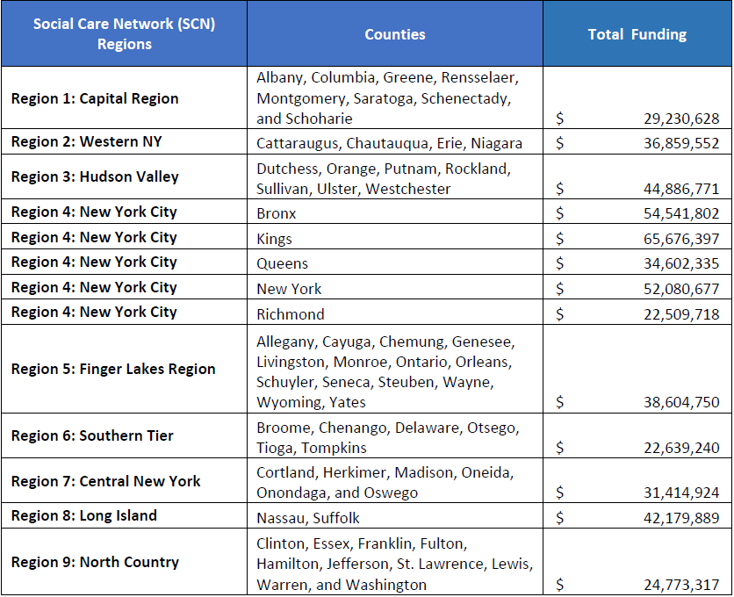
SCN Regions and Funding
Application due 4/5/24
Award date 6/1/24
Start date 8/1/2024 – 3/31/2027
Applicants can apply for multiple regions –must submit separate application for each region

Slide 11
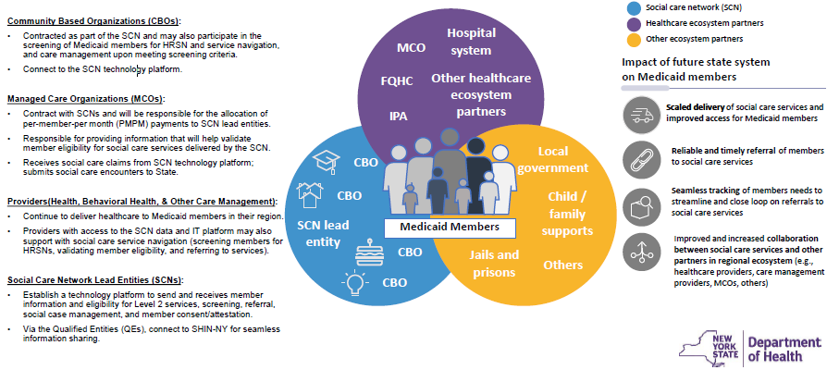
The Social Care Network Ecosystem
https://www.health.ny.gov/health_care/medicaid/redesign/med_waiver_1115/docs/2024-02-16_nyher_overview_slides

Slide 12
HRSN Services ($3.173B)
Two benefit tiers (based on screening)
High utilizers
Health Home enrollees
SUD, SMI, IDD
Homelessness
Pregnant individuals, post-partum up to 12 months
Post release CJI populations with chronic conditions/SUD /Hep-C
Juvenile justice involved and foster youth
Children <6, or <18 with chronic condition
Level 1 Services – All Medicaid Beneficiaries
Referrals to existing programs
Level 2 Services – Targeted Populations (right)
Housing
Nutrition
Transportation
Case Management

Slide 13
Enhanced HRSN Service Examples
Standardized Screening
Screen beneficiaries for HRSN
Collect demographic data
Housing
Navigation
Pre-tenancy and tenancy sustaining services
Nutrition
Counseling and classes
Food prescriptions
Transitional services
Rent/utilities
Home remediation
Home accessibility modifications
Medical respite
Medically tailored meals
Fresh produce, nonperishable groceries
Cooking supplies
Transportation
Reimbursement for public/private transportation for HRSN services and case management activities
Case Management
Outreach, referrals, education, linking programs, benefit application assistance
Connect to clinical case management
Employment, education, childcare, interpersonal violence resources
Follow up after services and linkages

Slide 14
Strengthen the Workforce ($694M)

Slide 15
Workforce Programs Overview
Career Pathways Training Program ($646M)
Student Loan Repayment
($48M)
New Careers in Healthcare
Healthcare Career Advancement
Workforce Programs
($694M)

Slide 16
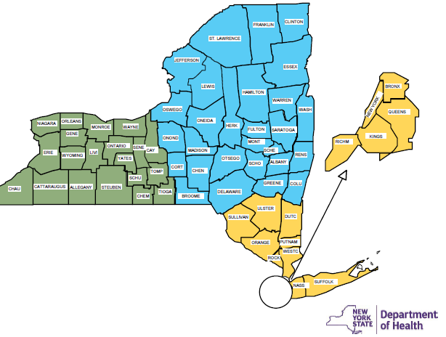
Strengthen the Workforce ($694M)
Student Loan Repayment for Qualified Providers
Must be in workforce shortage professions and make a 4-year commitment to practice panel with >= 30% Medicaid/Uninsured
Psychiatrists, primary care physicians, dentists, nurse practitioners, and pediatric nurse specialists
Career Pathways Training (CPT)
Fund training and education for career advancement and unemployed individuals who make a 3-year commitment to practice panel with >= 30% Medicaid/Uninsured
Administered by WIOs, 3 regions across the state
Nursing, Professional Technical, and Frontline Public Health Worker titles
https://www.health.ny.gov/health_care/medicaid/redesign/med_waiver_1115/docs/2024-02-16_nyher_overview_slides

Slide 17
Population Health

Slide 18
HERO ($125M)
Statewide contracted entity responsible for:
  Data aggregation, analytics, and reporting
  Regional needs assessments and planning
  Convene regional stakeholder engagement sessions
  Make recommendations to support advanced VBP arrangements and incorporating HRSN into VBP methodologies
  Conduct program analysis
Notes:
The HERO must be independent from the state or other government entities.

Slide 19
Medicaid Global Budget Initiative ($2.2B)
This funding will support financially distressed safety net hospitals transition to a global budget to incentivize and enable selected hospitals to focus on population health and health equity, improve quality of care, stabilize safety net hospital finances, and advance accountability
If the state applies for and is chosen as a participant in the CMMI AHEAD model and satisfies criteria as part of its participation in the model, it will be deemed to have met the requirements for this initiative. If it does not, the state will need to submit their own model that meets similar requirements.

Slide 20
Global Budgeting
Global budgets pay hospitals a pre-determined amount for services provided to a specific patient population during a given timeframe. This shifts risk from payers to hospitals, constrains healthcare cost growth, and incentivizes value-based care.
The waiver incentives specific hospitals in specific areas of New York to accept a global budget, specifically, the CMMI model States Advancing All-Payer Health Equity Approaches and Development (AHEAD) Model

Slide 21
Hospital Eligibility (for Incentive Funds)
Eligible hospitals must meet the following three criteria:
Private Not-For-Profit Hospitals in the Bronx, Kings, Queens, and Westchester Counties with a Medicaid and Uninsured Payor Mix of >= 45%
Private Not-For-Profit Hospitals with an average operating margin that is less than or equal to 0 percent over the past four years (Calendar Years 2019-2022) based on audited Hospital Institutional Cost Reports (excluding COVID relief funding and state-only subsidy)
Private Not-For-Profit Hospitals or their affiliates that received state-only subsidies due to financial distress in State Fiscal Years 2023 and/or 2024

Slide 22
AHEAD Model Components
Cooperative Funding Agreement
Hospital global budgets
Primary Care Ahead
support initial investments for states to begin planning activities during the Model’s pre-implementation period and the initial performance years of the model
provide hospitals with a fixed amount of revenue for the upcoming year for a specific patient population or program, such as Medicare fee-for-service beneficiaries
Primary Care AHEAD will align with ongoing Medicaid transformation efforts within each participating state and aims to increase Medicare investment in primary care.

Slide 23
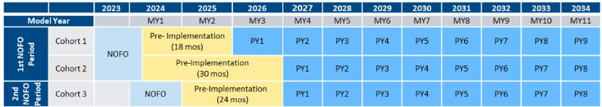
AHEAD Timeline
NYS will be applying for Cohort 3, with applications being due in August of 2024.

Slide 24
Colleen McVeigh
cmcveigh@hanys.org
518-431-7789

Slide 25


For Lori’s slides and presentation, please view recording.
LIHC Updates
March LIHC Member Spotlight:
Featuring Lori Andrade, Chief Operations Officer,
Health & Welfare Council of Long Island (HWCLI)

Slide 26

LIHC Updates
Core Clusters
Mental Health
Chronic Disease
Cultural Competency/Health Literacy
April Cluster meetings to be scheduled after this meeting; Ramona Bielawski to reach out and coordinate
Interested in joining a cluster? Email boliveri@nshc.org and you will be added to the list!

Slide 27




LIHC Updates
Community Service Society (CSS) Keep Long Island Covered (KLIC) Grant Final Update
By Francesca Damm, Program Director, Health Insurance Programs, Nassau-Suffolk Hospital Council

Slide 28
LIHC Updates
Community Service Society (CSS) Keep Long Island Covered (KLIC) Grant Final Update
Thank you to our members of the Long Island Health Collaborative!
Our outreach efforts helped us reach 1.5 million people on average per month. Efforts included social media posts, newsletters, flyer distributions, public transit campaigns, radio advertisements, print ads and blog posts.
Nassau Suffolk Hospital Council successfully assisted 1600+ Long Islanders in retaining their health insurance coverage since the start of this grant.
What other assistance does Nassau Suffolk Hospital Council provide?
  FE-ABD is a New York State-sponsored public health insurance application assistance program for people who are aged, blind, or disabled. We educate and assist New Yorkers with enrolling in and using public health insurance programs.
  We are Community Health Advocates. We help New Yorkers navigate the complex health care system by providing individual assistance, outreach, and education to communities throughout New York State.

Slide 29
LIHC Updates
NYS Prevention Agenda Updates
Next 6-year cycle: 2025-2030
  Most states moving away from disease-based priorities
  Shifting toward an SDOH model
  NYS 2 frameworks proposed:
    Current format with added topic of SDOHs
    Following Healthy People 2030 SDOH domains, strong emphasis on SDOH factors
Ad Hoc Committee to Support the NYS Prevention Agenda (PA)
  Consultation body for the PA
  Survey sent to stakeholders to inform prioritization/topics; findings to be presented at next Public Health and Planning Council (PHPC) meeting in mid-April, followed by feedback session
  Finalized framework to follow; guidance for new cycle posted summer 2024
  In December PHPC will have its new action plan
  2025-2027 CHNA/CSP due December 31, 2025
More updates about the new PA and our Work Group meetings to come
NYS DOH CHNA/PA Guidance and Timetable through Dec. 2028
Notes:
Started in Sept 2021 for the last cycle, worked through April/May
We can discuss our start date together– we can start any time

Slide 30
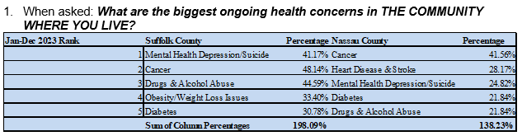

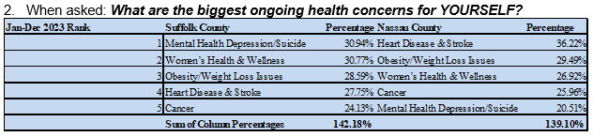
2023 Community Health Assessment Survey Analysis
LIHC Updates
Analyzed and Presented by Melissa Bauer Principal Healthcare Informatics Analyst, DataGen
403 surveys collected
Are the CHAS results a representative sample?
Questions for Melissa?
Full Summary Report and PowerPivot Excel File Available on the LIHC Website

Slide 31
LIHC Updates
Community Health Assessment Survey Promotion
English: https://www.surveymonkey.com/r/LICHASENG
Spanish: https://es.surveymonkey.com/r/LICHASESP
LIHC is still boosting links on social media
Please distribute links, QR codes and/or paper copies at:
  Digital newsletters
  Outreach events
  Social media
  Etc.
All CHAS surveys, links, social media posts, and printable QR code signs are available in a Toolkit via Google Drive
IF YOU CANNOT ACCESS GOOGLE DRIVE, please email boliveri@nshc.org to request the CHAS Toolkit materials directly via email

Slide 32
Ongoing Engagement
Collaborative Communications
Bi-weekly email newsletter to 400+ contacts
Submit your free events, resources, jobs, and more to boliveri@nshc.org
Subscribe to Collaborative Communications
LIHC Events Calendar
Submit your events here
Walk with a Doc / Walk Safe with a Doc
Opportunity to partner
LIHC handles coordination, just asks for your efforts to co-promote

Slide 33
Ongoing Engagement
Upcoming Walks
Walk Safe with a Doc: New Hyde Park
Wednesday, April 17, 2024
1 PM at Hillside Library
155 Lakeville Rd, New Hyde Park, NY
Led by Jerry A. Rubano MD FACS, NYU Langone Hospital-Long Island
Register Here
Walk Safe with a Doc: Smithtown
Tuesday, April 30, 2024
1 PM at St. Catherine of Siena Hospital
50 Rte 25A, Smithtown, NY 11787
Led by Dr. Robert Courgi, St. Catherine of Siena Hospital
Register Here
Walk with a Doc: Harborfront Park
Saturday, May 18, 2024 at 10 AM
Harborfront Park, Port Jefferson, NY 11777
Led by Dr. Shamim Khan, Cardiologist, Catholic Health
Walk with a Doc: Belmont Lake State Park
Saturday, June 15, 2024 at 10 AM
Belmont Lake State Park
Led by Dr. Keasha S. Guerrier, Family Medicine, Long Island Jewish Valley Stream Hospital
Walk with a Doc: Sunken Meadow
Saturday, September 21, 2024 at 10 AM
Sunken Meadow State Park
Led by Dr. Anupama Paranandi, Preventive Medicine Resident, Stony Brook Medicine

Slide 34
Future 2024 Meetings
The LIHC is moving! New office, still in Hauppauge
Hybrid quarterly meetings to continue, registration links on LIHC website
    Thursday, June 27, 9:30-11:30 AM
    Thursday, September 26, 9:30-11:30 AM
    Thursday, December 5, 9:30-11:30 AM

Slide 35

Discussion

Slide 36
Adjournment
Thank you!
www.lihealthcollab.org
(631) 963-4167
lihc@nshc.org

