Slide 1
September 23, 2021
Quarterly Meeting

Slide 2
Welcome & Introductions
Thank you for joining us! Please share your name and what organization you are representing in the chat box.

Slide 3
LIHC Updates
Refreshed Website
New logo, colors; working on content
lihealthcollab.org
Flu Campaign
To come early October

Slide 4
LIHC Updates
Alliance Health Communications
Several clients thus far
Full menu of services: https://suburbanhospitalalliance.org/alliance_health/

Slide 5
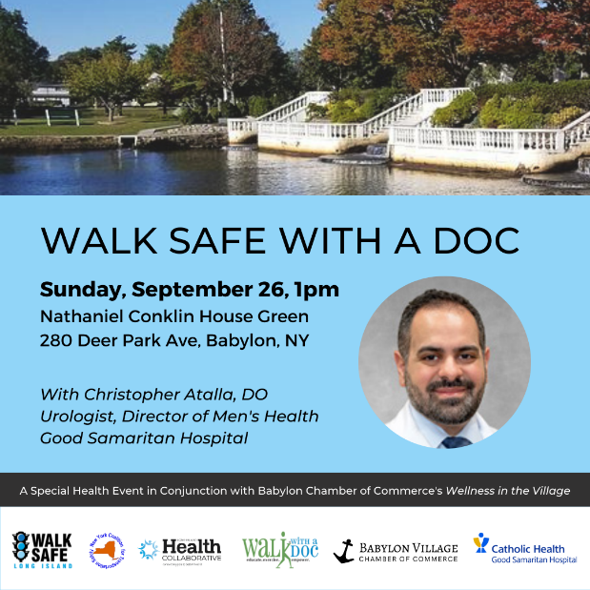
LIHC Updates
Upcoming Events
Walk Safe with a Doc Wyandanch Saturday, September 25 at 10am Starting at Wyandanch Park
Walk Safe with a Doc Babylon Sunday, September 26 at 1pm Starting at Nathaniel Conklin House
Opportunities for partnerships; let us know!

Slide 6
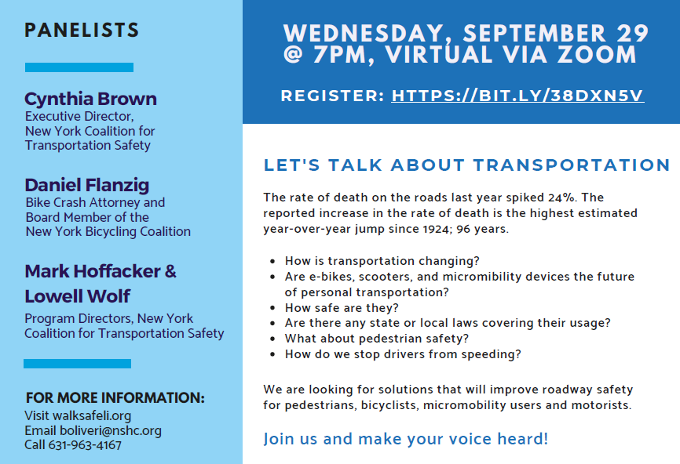
LIHC Updates
Upcoming Events
Walk Safe Long Island Virtual Town Hall
Wednesday, Sept. 29 7pm via Zoom
Register:
HTTPS://BIT.LY/38DXN5V

Slide 7
LIHC Updates
CHNA 2022 Workgroup Meetings
First Tuesday of the month
First meeting: September 1, 2021 (recording and summary online)
Next meeting: Tuesday, October 5, 2021

Slide 8
LIHC Updates
Community Health Assessment Survey Social Toolkit
Need collaborative effort
LIHC to boost survey on Facebook
Please take advantage of co-branded social media toolkit
Data in = Data out

Slide 9
Featured Presentations
Suicide Prevention Month
Amy Miller, LCSW Community Engagement and Partnership Coordinator for Suicide Prevention for Veteran’s Affairs VA Medical Center, Northport
Ann Morrison, Area Director Long Island Chapter, American Foundation for Suicide Prevention
Tara Larkin-Fredericks, Director of Special Projects Association for Mental Health and Wellness

Slide 10
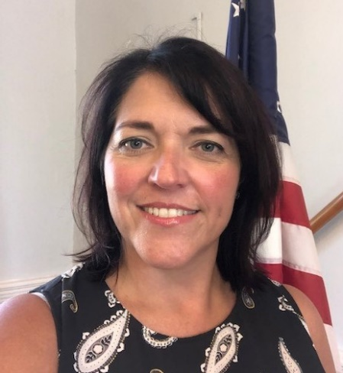
Did you know?
An average of 20 Veterans die by suicide each day. Only about 6 of the 20 are recent users of Veterans Health Administration services.
Did you know?
69% of Veteran deaths by suicide involve firearms.
VA is taking a public health approach with Suicide Prevention 2.0 to combine community and clinically based interventions. The priority areas of focus include:
Identify Service Members, Veterans and their Families (SMVF) and screen for suicide risk.
Promote connectedness and improve care transitions.
Increase lethal means safety and safety planning.
Community Engagement and Partnership Coordinator for
Suicide Prevention for Veteran’s Affairs
Amy Millheiser, LCSW
VA Medical Center
Northport, NY
(631) 261-4400 ext 5574

Slide 11
Ann Morrison Area Director Long Island Chapter American Foundation for Suicide Prevention
amorrison@afsp.org
516-869-4215
Cell: 347-913-2178

Slide 12
Project Hope Association for Mental Health and Wellness
Tara Larkin-Fredericks
Director of Special Projects
tfredericks@mhaw.org

Slide 13
The combination of physical distancing, economic stress, barriers to mental health treatment, pervasive national anxiety, and a spike in gun sales are creating what JAMA Psychiatry referred to as “a perfect storm” for suicide mortality.

Slide 14
About NY Project Hope
NY Project Hope is a statewide crisis counseling initiative available to every New York resident.
The Crisis Counseling Program provides support, outreach, and education to assist individuals and communities coping with COVID-19.
It is a strengths-based program offering support that promotes resilience, empowerment, and recovery… always free, confidential, and anonymous

Slide 15
Our Services
For Individuals/Families we provide;
Information
Education
Emotional support
Links to resources
For organizations/Groups we provide presentations on;
Recognizing common reactions to COVID
Building coping skills for the recovery process
Managing disaster-related stress
Targeted support groups

Slide 16
Project Hope Emotional Support HelpLine
(631) 471-7242 ext. 1800.
Trained crisis counselors are available 9:00am to 7:00pm, Monday through Friday.
You can also send an email to projecthope@mhaw.org

Slide 17
Other Resources provided by Association for Mental Health and Wellness
Mental Health Helpline Mental Health Helpline 631-471-7242 ext. 2 helpline@mhaw.org
Joseph P. Dwyer Veterans Peer Support Project
For group information, please contact (631) 853-8345 or via email at vetspeertopeer@suffolkcountyny.gov.
Peer Support Line
Monday to Friday, 9:00am-5:00pm
We can be reached by calling 631-471-7242 ext. 1217 for one-to-one telephone mutual support.
Healing Connections Peer Support Group
631-471-7242 ext. 1390 Email: healingconnections@mhaw.org

Slide 18
Moving Forward
Quarterly meetings to continue; other meetings as/if needed
2022 CHNAS Work Group to continue
Next meeting: Thursday, December 9, 2021 at 9:30am-11:30am

Slide 19
Adjournment
Thank you!
www.lihealthcollab.org
(631) 257-6964 info@lihealthcollab.org

