Slide 1
December 9, 2021
Quarterly Meeting

Slide 2
Welcome & Introductions
Thank you for joining us! Please share your name and what organization you are representing in the chat box.

Slide 3
LIHC Updates
CHNA 2022 Work Group
Last meeting: Tuesday, December 7, 2021 at 1 PM
Recording available online
Next meeting: Tuesday, January 4, 2021 at 1 PM
CBO Survey and CHAS Survey Toolkits
Sample posts and flyers with QR codes for in-person events
https://drive.google.com/drive/folders/19hqHc_0ZeKOdLlFAVhi8PjMiagGi8iQj?usp=sharing
Data In = Data Out

Slide 4
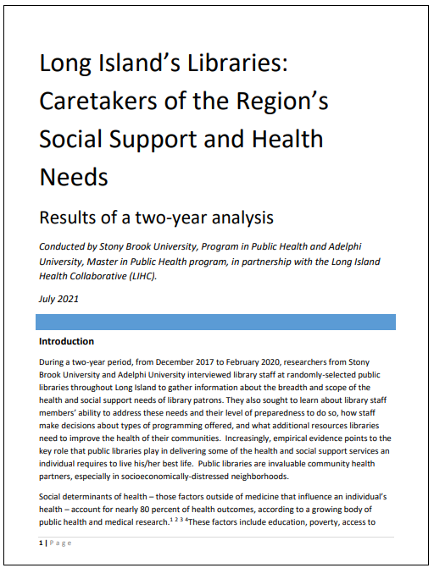
LIHC Updates
Library Research Project Final Report
Available on LIHC website: https://www.lihealthcollab.org/healthy-resources/healthy-libraries

Slide 5
Library Research Project
Top 5 Identified Health Needs
Mental health
Exercise
Diet
Opioid use
Personal Health
Top 5 Identified Social Service Needs
Homelessness
Technology literacy
ESL/LOTE
Unemployment
Food
Correlation to CHAS data

Slide 6
Featured Presentations
LIHC Academic Partners Practicum Opportunities
Hofstra University
Martine Hackett, PhD, MPH, MPH Program Director
Stony Brook University
Michele Bayley, MPH, Practicum Coordinator
Pascale Fils-Aime, MPH, MBA, Practicum Placement and Community Engagement Coordinator
Adelphi University
Natalie Madray, Practicum Coordinator

Slide 7
Hofstra University Master of Public Health Program
Applied Practice Experience

Slide 8
Hours-based Option
Students select a location where they will work for 150 hours
Acceptable internship sites include:
Governmental public health agency;
Community-based public health agency or organization;
Health care institutions (working on public health issues)
Academic institutions (working on public health issues)

Slide 9
Portfolio Option
Students will produce specific products that demonstrate competency attainment. They must create at a minimum of two products in these practical settings. These products will be presented portfolio style. Examples of the type of products that are appropriate for the applied practice experience are:
written assignments
projects
videos
multi-media presentations
spreadsheets
websites
posters

Slide 10
Academic Partnership for Practicum Success
Michele Bayley, MPH
Practicum Coordinator
Pascale Fils-Aime, MPH, MBA
Practicum Placement and Community Engagement Coordinator

Slide 11
Stony Brook’s Program in Public Health Practicum
Provides “hands on” supervised experience in the field of public health – 135 or 100 hours depending on student’s concentration (Health Analytics, Community Health, Health Policy and Management, or Generalist)
Designed to allow student to apply academic knowledge and acquired skills while developing specific public health projects
Conducted in partnership with an agency or organization that provides a public health service
Meets Council on Education for Public Health (CEPH) requirements
Notes:
Council on Education for Public Health (CEPH) requires students to choose three foundational competencies and two concentration competencies
CEPH does not specify the number of hours to satisfy the practicum requirement (some schools/programs have 300 hour practicums). The 135 hours is a SUNY requirement to earn 3 credits for the practicum course
CEPH requires the project to result in two deliverables given to the organization as a service
Students cannot be paid for their practicum project; however, student may be able to work on a project for their current employer as long as the practicum activities fall outside regular job duties and they do not receive any compensation for these extra responsibilities
Two or more students can work on a practicum project, as long as each students create their own unique set of goals and objectives

Slide 12
Stony Brook’s Program in Public Health Practicum
Students bring diverse expertise to their projects
Many are pursuing dual degrees: MD/MPH, DDS/MPH, MSW/MPH, MBA/MPH, MPH/MAPP, and MPH/MS in Nutrition
A supervisory team is assembled for each practicum consisting of the following advisors:
Practicum Advisor (Core PPH faculty)
Preceptor (works in practicum organization)
Practicum Coordinator (Prof. Bayley with assistance of Pascale Fils-Aime)

Slide 13
Preceptor Expectations
The Preceptor should be a skilled practitioner willing to serve as the student's mentor and guide. The Preceptor will:
Provide guidance on development of practicum proposal.
Provide a supervised unpaid practical experience within which the student will provide up to 135 hours with set goals and objectives.
Orient the student to the organization policies and procedures relevant to his or her work with the organization.
Spend time with the student, providing periodic and timely feedback and guidance.
Evaluate student’s performance.
Notes:
Preceptor Expectations

Slide 14
Preceptor Benefits
You and your organization can benefit from the skills, knowledge, and competencies of Stony Brook’s MPH students during their unpaid training in a practice setting to assist with a practical need such as:
grant writing
program planning
program evaluation
policy analysis
needs assessment
database design and management
data analysis using statistical methods
final reports for dissemination to internal/external decision-makers
educational materials development
social media outreach
Students must provide their preceptor with two agreed upon deliverables that meet the needs of the organization.

Slide 15
Interested?
Please contact:
Prof. Michele Bayley, Practicum Coordinator
Michele.Bayley@stonybrookmedicine.edu
Pascale Fils-Aime, Practicum Placement and
Community Engagement Coordinator
Pascale.Fils-Aime@stonybrookmedicine.edu

Slide 16
Contact: Natalie Madray Practicum Coordinator nmadray@adelphi.edu
Slides available on LIHC Website
Master of Public Health
Practicum

Slide 17
1115 Medicaid Waiver News
CMS formally asked the state to submit an application
However, months away from any action
Population health, social determinants of health key influences shaping state’s app

Slide 18
Moving Forward: 2022
Continued data collection
Opportunities for partnership
Refreshed SPARCS hospitalization data
LIHC collaboration with AARP of Long Island

Slide 19
Comprehensive health communications services
Strategic campaign development and implementation for the not-for-profit health, social services, and public health sectors
Competitive rates at a fraction of the cost for similar services offered by commercial agencies
http://suburbanhospitalalliance.org/alliance_health/

Slide 20
Moving Forward: 2022
Quarterly meetings to continue, registration links on LIHC website
Thursday, March 31, 2022
Thursday, June 30, 2022
Thursday, September 29, 2022
Thursday, December 8, 2022
2022 CHNA Work Group to continue through spring
Next LIHC meeting: Thursday, March , 2022 9:30-11:30 AM

Slide 21
Discussion

Slide 22
Adjournment
Thank you!
www.lihealthcollab.org
(631) 257-6964 lihc@nshc.org

