Slide 1
Long Island Population Health Improvement Program
(LIPHIP)
WIFI password: kayla1393
July 13, 2017
This meeting is now being recorded.

Slide 2
Announcements and Updates
Update to LIPHIP Charter and Partner Agreement
Collective Impact Think Tank
  Vendors’ proposals due 5 p.m., July 24
September Meeting Date Change
  New Date 9/28/17

Slide 3
DSRIP Partnership Updates
Suffolk Care Collaborative
Nassau Queens PPS

Slide 4
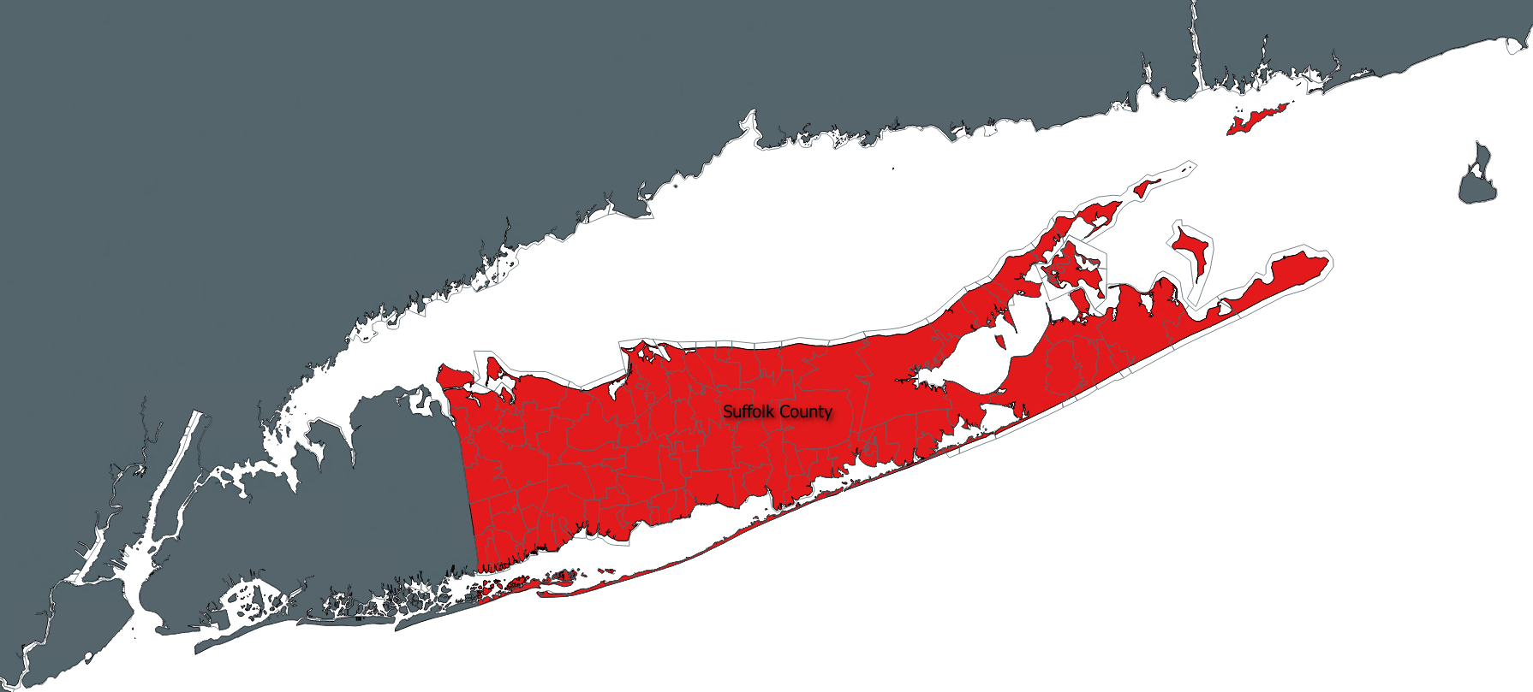

Partnership Opportunities for CBO’s
Stephanie L Burke. MS, MHA, CHES – Administrative Manager
Amanda Chirco M.Ed – Program Manager
Lyndsey Clark, MS – Community Liaison
Sofia Gondal, MS – Community Liaison

Slide 5
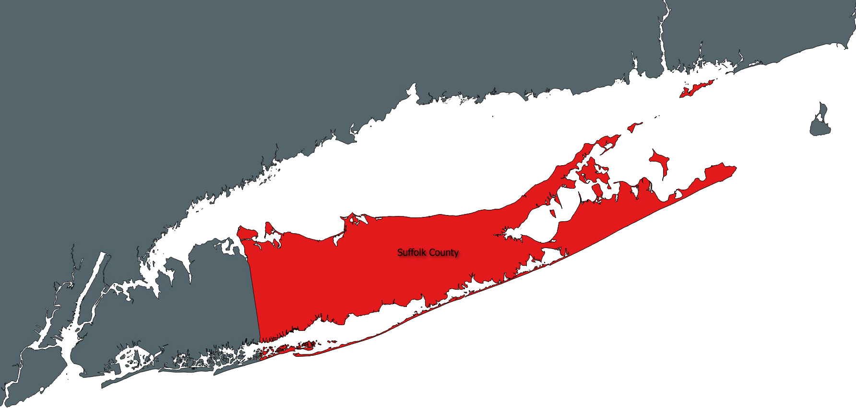
SCC updates
New Affiliate Agreement Status for CBO’s
HITE Suffolk County Advisory Group
Community Health Activation Program (CHAP) Development Plan

Slide 6
The dsrip perspective
Community based organization engagement
CBOs are experienced in delivering services that are culturally responsive and provide services that address an individual’s social determinants of health (SDH).
Recognizing the strong linkage between SDH and health outcomes, the SCC is looking to formally engage CBOs to collaborate on Integrated Delivery System (IDS) efforts and SDH initiatives.
Notes:
The social determinants of health are fundamental to supporting medical interventions and improving health outcomes.
VBP Roadmap speaks to measuring SDH and the success of integrating SDH into managed care for the Medicaid population, the SCC has coordinated a similar model through participation of CBOs in DSRIP.

Slide 7





Healthy People 2020 Social Determinants of health
Economic Stability
Education
Social
Family & Community
Health
Neighborhood & Environment
Notes:
Healthy People 2020 states that “health disparities adversely affect groups of people who have systematically experienced greater obstacles to health based on their racial or ethnic group; religion; socioeconomic status; gender; age; mental health; cognitive, sensory, or physical disability; sexual orientation or gender identity; geographic location; or other characteristics historically linked to discrimination or exclusion.”
Community Integration is defined as the ability to make connections so that providers and communities have access to tools they need to address social determinants of health – which may not presently be known to them. CBO’s address many of these SDH as they work with their perspective communities and your hard work has made notable changes in the targeted areas. NYS DOH has categorized CBO’s and you will learn more about them in the next slide.

Slide 8
community based organization
Nys doh tier definitions
Tier 1:
Tier 2:
Tier 3:
Non-profit, non-Medicaid billing, community based social and human service organization.
Non-profit, Medicaid billing, non-clinical service providers.
Non-profit, Medicaid billing, clinical and clinical support service providers.
(I.e. transportation, care coordination).
(I.e. housing, social services, religious organizations, food banks, peer groups, community education, coalitions, academic institutions, Government agencies and councils).
(I.e., licensed by NYS DOH, OPWDD, OASAS, mental health and substance use disorder providers home health care services, emergency medical services, care management agencies).
Commonality Addressing the Social Determinants of Health
Notes:
Everyone is here today representing CBO’s but did you know the NYS DOH has categorized CBO’s into tiers – here is a picture of their framework….
Community Based Organizations (CBOs) have been identified by New York State Department of Health and the Suffolk Care Collaborative (SCC) to be essential in the support of health care outcomes within the Medicaid and uninsured populations.

Slide 9

What is the opportunity?
Social determinants of health play the most important role in overall health and yet, our medical care system has not yet engaged in addressing and measuring SDH interventions.
Can your organization identify innovative ideas, programs or services to improve outcomes?
Notes:
Pose as a question to the CBO’s
Give an opportunity to brainstorm or even comeback with some ideas. (this can be the competition for CBO’s to receive funding based on their innovation and the SCC needs.)
If you can demonstrate a particular intervention, service, or program results in improved outcomes, you can justify that it should be offered/provided to a population and that the entity providing it should be compensated by the VBP contractor. We are beginning our journey to explore the opportunity at hand collaboratively.
Recognizing the strong linkage between SDH and health outcomes, the SCC is looking to formally engage CBOs to collaborate on IDS efforts (community integration) and SDH initiatives through our Affiliate agreements which I will explain on the next slide.

Slide 10
Community based organization engagement model
Affiliate
Formal Agreement
Non Binding
Coalition Partner
Formal Agreement
Non Binding
IDS Network Provider
IDS Network Provider
Data Sharing/BAA
Participate in Special Projects & Learning Collaboratives
Specific DSRIP project scope of work tied to performance based funds flow payments
No Funds Flow Payment
Participate in Special Projects & Learning Collaboratives
Community Integration Value
Prepare for VBP
Prepare for VBP
Opportunity
Notes:
The SCC has designed two roles a CBO can play within the SCC and DSRIP.
An affiliate agreement is a non-binding agreement to allow a CBO to become a member of the IDS and participate in community integration activities. Specifically, to participate in Learning Collaboratives, such as this one, become further educated in VBP and may participate in special projects the affiliate deems appropriate. At this time there is no direct funds flow, however there is added value by way of participation in the community integration activities. They will also help you gain necessary experience when VBP contractors begin to converse with you about potential contracting arrangements.
The coalition partner participation agreement is also a formal agreement, non binding and allows the partner to participate in the opportunities set forth in the affiliate agreement. The difference includes the organizations participation in a specific DSRIP project, with a defined scope of service, performance goals and payment structure – very similar to the goals set forth in the VBP Roadmap for CBO contracting.
As we work together in the coming years the goal of SCC is to look for ways our Affiliates can become Coalition Partners by designing community integration and SDH initiatives to better serve our attributed population.
Your participation in the IDS as an Affiliate will further demonstrate how we function as a “coordinated network” and not as configuration of independent organizations. It is also anticipated that, over time, the IDS will grow and the relationships across providers and organizations will become formalized. Your participation will support (1) expanded access to high quality primary care, (2) payment reform, (3) the rebalancing and restructuring of health delivery, and (4) the enhancement of community-based services and behavioral health services. Your participation will be driven by measurable community needs and quality improvement activities.

Slide 11

New affiliate agreement next steps
Affiliate Agreement contracting will initiate on June 13, 2017 for all CBO’s and close on July 31 2017.
Please pick up a copy of your Affiliate Agreement folder today.
Once signed, a member of the SCC will schedule a brainstorming meeting to learn about your program’s services and explore DSRIP project participation. There will be opportunities at this time to talk about a potential Coalition Partner Participation Agreement scope of work.
Link to Affiliate Agreement webpage on SCC website:
As we continue to prepare for the transition of the Medicaid payment system to value based payment contracting, the SCC will be announcing additional CBO learning opportunities around value based payment models (in-person and eLearning modules) coming this Fall 2017.
For more information of questions about the contract, please contact:
Alyssa Scully, MHA, PMP
Sr. Director, Project Management Office
Suffolk Care Collaborative
Tel: (631) 638-1369
Alyssa.scully@stonybrookmedicine.edu

Slide 12
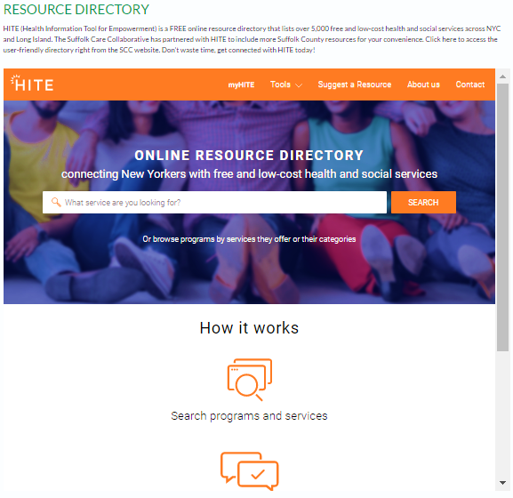
HITE Suffolk County Advisory Group
Open to Suffolk County partners using HITE – including hospitals, community providers, and CBO’s
Participate in an advisory meeting on the HITE’s features, content, and usability.
Date: Wednesday, August 9th, 2017
Time: 2:00 p.m. – 4:00 p.m.
Location: Island Harvest, 40 Marcus Blvd, Hauppauge, NY 11788
  Sign Up Today!
    For more information, please contact:
Lyndsey Clark, Community Engagement Liaison
Suffolk Care Collaborative
T: 631-638-1779
E: Lyndsey.Clark@stonybrookmedicine.edu
Pre

Slide 13





Community health activation Program
(CHAP) Overview
DSRIP Project 2di - Implementation of Patient and Community Activation Activities to Engage, Educate and Integrate the uninsured and low/non-utilizing Medicaid populations into Community Based Care
Program Overview:
The SCC’s Community Health Activation Program (DSRIP Project 2di) is a CBO-led in-reach and outreach program aimed to identify, engage, educate and integrate the uninsured and low/non-utilizing Medicaid populations into community based preventive care services.
Current program model includes an in-reach and outreach model and has engaged 5 organizations to participate in community activation activities.
Measures will score the programs ability to move an individual up in Patient Activation Measurement Score annually, Reduce the number of individuals who are engaged in the programs avoidable emergency department use and number of individuals who have a PCP well visit if classified as a LU or NU of Medicaid services within past 24 months.
Program Engagement:
5,900 surveys completed since January 2017
Annual goal for DY 3 is 34,000, beginning DY4 annual goal will increase to 45,000.
6

Slide 14
Community Health activation Program
Development plan & Call for engagement
We’re looking for interested community partners to join our efforts in Community & Patient Activation.
We’re welcoming interested organizations to reach out to us directly!
Engagement may include:
1) Hosting PAM Surveyors on-site to engage clients as a “Survey Site”.
2) Becoming a “PAM Provider” of Surveys for the program in Suffolk County.
3) Becoming a “Navigation & Coaching” provider for the Program in Suffolk County.
Program Representative:
Amanda Chirco, M.Ed
Project Manager,
Community Health Initiatives
Suffolk Care Collaborative
Amanda.Chirco@stonybrookmedicine.edu
Office Phone: 631-638-1774
Fax: 631-638-1009
11

Slide 15
Northwell Health
CBO Engagement
Jessica Byrne, MPH
Project Manager
Northwell Health Solutions
jbyrne3@northwell.edu

Slide 16




Determining a “Hot Spot”
Areas containing the first quintile of high Medicaid inpatient and emergency department utilization.
Areas that had similar race and ethnicity characteristics.
Ambulatory Sensitive Conditions, Readmissions, and Behavioral Health.
Areas with high rates of Medicaid utilization and high density of Medicaid recipients.

Slide 17
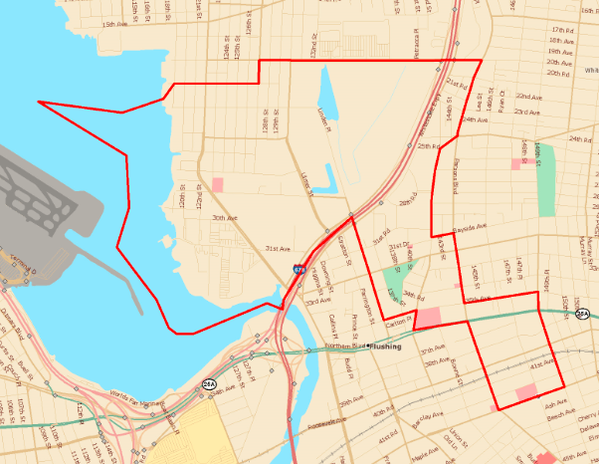
College Point/North Flushing
20th Ave.
127th St.
Parsons Blvd.
Union St.
Whitestone Expy
Parsons Blvd.
Linden Pl.
35th Ave.
149th St.
Parsons Blvd.
Sanford Ave.

Slide 18

College Point/North Flushing
College Point/North Flushing is an area that has:
11,139 Medicaid recipients
30% of Beneficiaries have increased rates of Overall Composite, Acute and Respiratory PQIs.
It is also an area of increased smoking rates above the NYC average rate.
The poverty rate (22%) is above the Queens average of 16%.
The area has a large foreign born population (64%) with 80% of the population speaking a second language.
Eastern Asia represents the largest foreign born group composed of individuals from China and Korea. South America is the second largest group composed of individuals from Colombia, Ecuador and Peru.
The top 5 languages spoken other than English in descending order are Chinese (34%), Spanish (18%), Korean (15%) other Indic (2%) and other Indo (1%).

Slide 19
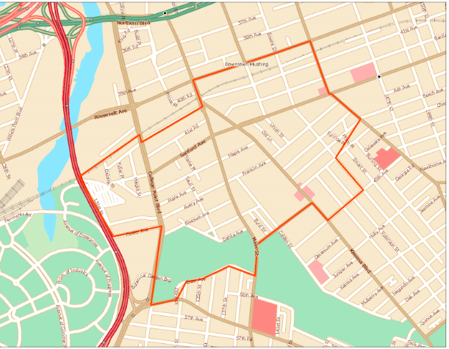
Flushing
Roosevelt Ave.
Parsons Blvd.
41th Ave.
Railroad
Van Wyck Expy.
45th Ave.
Elder Ave.
College Point Blvd.
Elder Ave.

Slide 20

Flushing
Flushing is an area that has:
15,885 Medicaid recipients
40% of the cluster’s population with increased rates of Acute PQIs, Serious Mental Illness admissions and 30 Day Readmissions.
It is also an area of increased smoking rates above the NYC average rate. The poverty rate (23%) is above the Queens average of 16%.
The area has a large foreign born population (75%) with 88% of the population speaking a second language. Eastern Asia represents the largest foreign born group composed of individuals from China and Korea.
South Central Asia represents the second largest group composed of individuals from India and Pakistan.
South America represents the third largest group composed of individuals from Colombia and Ecuador.
The top 5 languages spoken other than English in descending order are Chinese (50%), Spanish (15%), Indic (5%), Korean (5%) and Urdu (3%).

Slide 21
Glen Cove

Slide 22
Glen Cove
Glen Cove is an area that has:
2183 Medicaid recipients
Increased rates of Non-Serious Mental Illness.
A poverty rate (20 %) is above the Nassau average of 6%.
A population is 40% foreign born comprised primarily of immigrants from Central America specifically El Salvador
52% of the population speaking a second language.

Slide 23


Community Support Services
Education & Immigration Support
Job Training
Behavioral Health
Community Outreach:
Flushing
Primary Care
Providers
Korean Community
Services
Patient
National Alliance
for Mental Illness
Chinese – American
Planning Council
Tiered Empowerment
Network
YMCA

Slide 24
Education
Awareness
Advocacy
NAMI Helpline
Child and Youth Services
Senior Services
Workforce Development
Mental Health Clinic
Women’s Health
Chronic Disease
Social Services
Education & Immigration
Interactive Online Referral Database
Benefit Screening
Financial Coaching
Housing
Immigration
Legal Services
Chronic Disease Self-Management Program
Diabetes Prevention Program
Tobacco Use Cessation
Health/Wellness
Youth Programs

Slide 25





Patient Partner Connections
Patient struggling to manage diabetes
Patient has positive PHQ score
Multilingual PCP sees Korean speaking patient.
Patient referred to KCS/YMCA for CDSMP Course
Patient PAM score increase achieved
Patient provided information on NAMI for support
Patient gets warm handoff for to referral to KCS Mental Health clinic/BH Clinic
Integrated care for coordinated patient support

Slide 26
Health Policy on the Move –
Why It Matters to You
Kevin Dahill, President and CEO of the Nassau-Suffolk Hospital Council and Northern Metropolitan Hospital Association, which comprise the Suburban Health Care Alliance. Kevin Dahill also serves as Executive Vice President of the Healthcare Association of New York State (HANYS)

Slide 27

Networking, Stretch Break & Sign up for Workgroup Participation

Slide 28
LIHC Walking Events
Suffolk County
  Thursday, August 17, 4:30 p.m.
  Caleb Smith State Park, Smithtown
Nassau County
  Thursday, August 31, 5:30 p.m.
  Bethpage State Park, Bethpage

Slide 29
County Walking Events
Suffolk County Marathon
  Sunday, October 29, 8:00 a.m.
Nassau County 5k Family Fun Walk & Health Expo
  Saturday, September 30, 10:00 a.m.

Slide 30

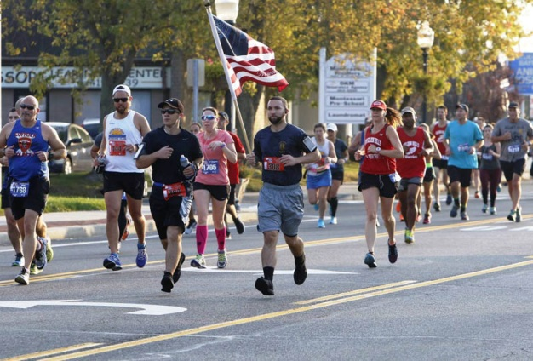


Suffolk Marathon
Come out and support Suffolk County Veterans on Sunday, October 29th, 2017 at 8:00 AM

Slide 31
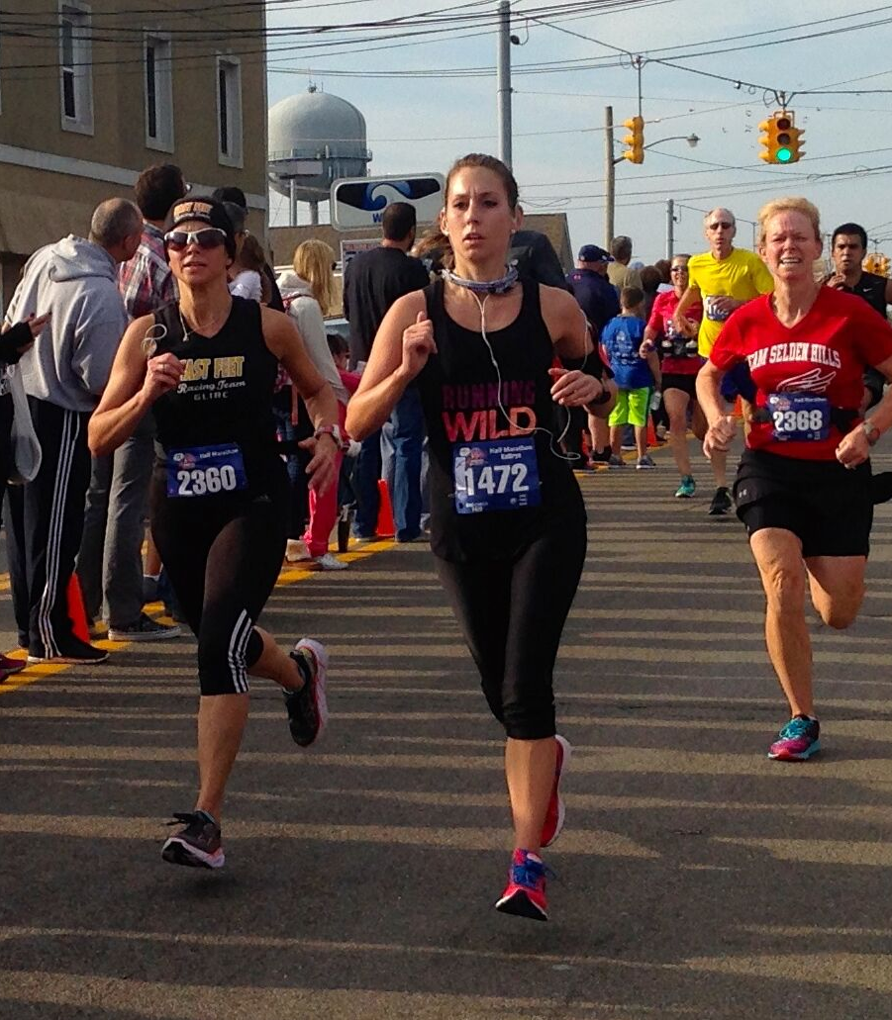
Events
Full Marathon
Half Marathon
5k
4 Member Relay

Slide 32
FreedomFest: Taste of Long Island Festival
Live Music
Local Food
Award wining local wines
And craft brews
Bringing the best of Long Island straight to you!
Starting at 9:00 AM
Highlighting the best of local Long Island
Free tasting for race participants

Slide 33

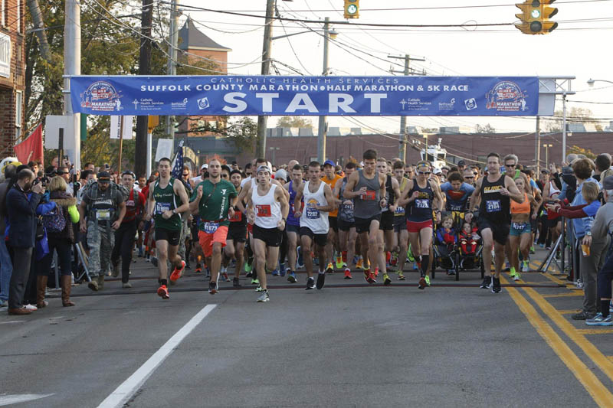
To register visit
www.SuffolkMarathon.com

Slide 34
Nassau County Family 5K Walk & Health Expo
Saturday, September 30, 10:00 a.m.
Free registration
www.Nassau5k2017.eventbrite.com
Contact Carolyn McCummings Nassau County Department of Health
  cmccummings@nassaucountyny.gov
  O- 516-227-9437
  F- 516-227-9610

Slide 35

Dog Owners Walk More Per Day

Slide 36
Academic Partners
Library Asset Mapping Project
  Uncovering the health-related and social-service related programming occurring at public libraries throughout Nassau and Suffolk counties

Slide 37
Community Health Assessment Survey
Title reflects the addition of eastern Queens to the catchment area
WHAT DO YOU NEED TO DO?
  Online: The link to this survey remains the same www.surveymonkey.com/r/CMLICHAS
  Paper: Replace your current surveys. Download at lihealthcollab.org/member-materials

Slide 38
Cultural Competency
Central branded website
Refresher session qualitative analysis
New tools

Slide 39
Questions/Feedback?

